Slide 1
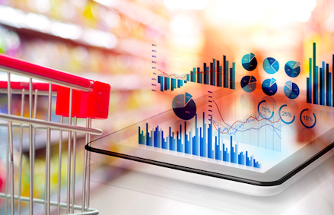
RETAIL SALES DATA ANALYSIS
PREPARED FOR :- Vahid Behzadan,Phd
PREPARED BY:-Ariga Tejasimha , Srimanikantha Arjun Karimalammanavar , Rahul Akkineni
Rahul Akkineni

Slide 2
PROBLEM STATEMENT MOTIVATION AND OBJECTIVES
We have to recommend the company the inventory management throughout the year by considering the sales report of three months.
We will also the recommend the company where about to focus on which products to be promoted
We will recommend the company throughout the year by considering the dataset for 3 months of sales at 3 different locations.By considering on time series modelling of sales which has patterns of sales based on time and location analysis based on the store present which will give insight to company to knew it’s target audience or customers.
We will recommend the company throughout the year by considering the dataset for 3 months of sales at 3 different locations.By considering on time series modelling of sales which has patterns of sales based on time and location analysis based on the store present which will give insight to company to knew it’s target audience or customers.
We will recommend the company throughout the year by considering the dataset for 3 months of sales at 3 different locations.By considering on time series modelling of sales which has patterns of sales based on time and location analysis based on the store present which will give insight to company to knew it’s target audience or customers.

Slide 3
OVERVIEW OF DATA COLLECTION
In this dataset there are 17 columns which gives complete insight of super market sales for three months from December 2018 - March 2019.It has data of supermarket which is located in three different locations. It has columns like payment methods, types of customers , date of purchase, time of purchase, ratings of customers and product line which is categorised groups like food and beverages, fashion accessories and electronic accessories
There is no need of data cleaning techniques but we have converted the categorical features to numerical for better computation.

Slide 4
MODELLING TECHIQUES
We have used Linear Regression, Decision Trees, Rigid and XGBoost (Extreme gradient )models in this for analysis.
All Models are performed on City ,Gross income and Product line
The Best model we got for this analysis is XGBoost as it gives least RMSE(Root Mean Square Error)
By considering the user corrabartion and item corrarbartion technique are used

Slide 5
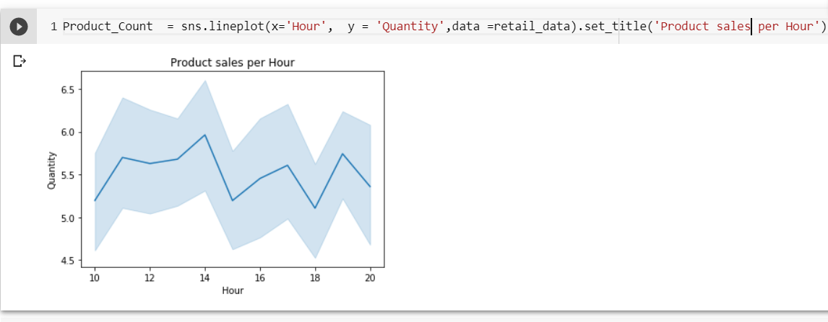
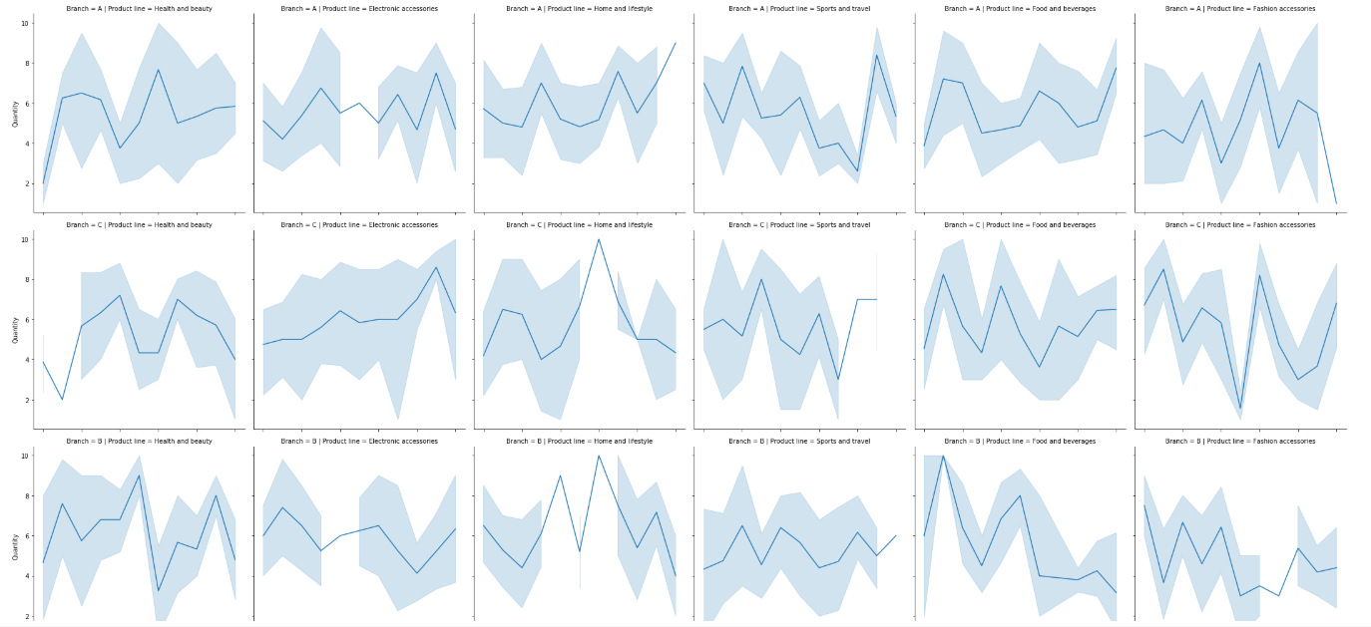
RESULTS AND ANALYSIS
Considering the time series modelling we have concluded that most of the items are sold at 14:00 in all locations
Food and beverages sakes are generally high in all branches at evening especially around 19:00
Fashion and accessories is the highest product line sold while health and beauty is the lowest

Slide 6
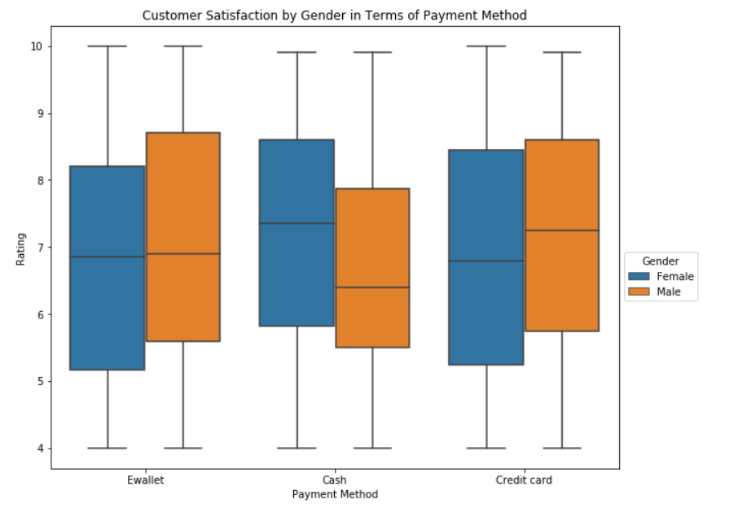
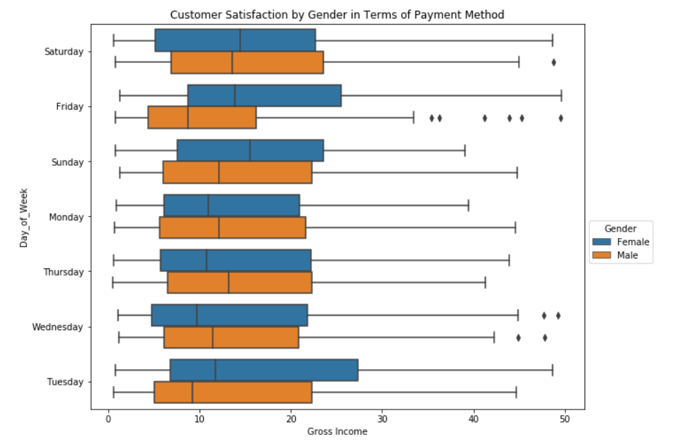
RESULTS AND ANALYSIS
Considering the location analysis we can depict that location B(Naypyitaw) has lowest rating comparing to other two branches.
Considering all locations males having higher satification rating for shopping experiencing when they use e-wallets or credit cards while female have higher satification rating when they use cash.
Females tends to buy more stuff in tuesdays than any other day. Whereas male shopping doesn’t seem to change that much except for Friday.

Slide 7
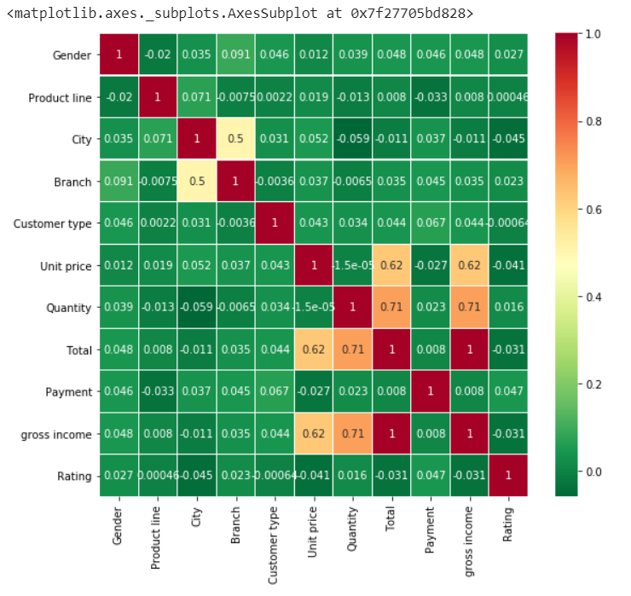
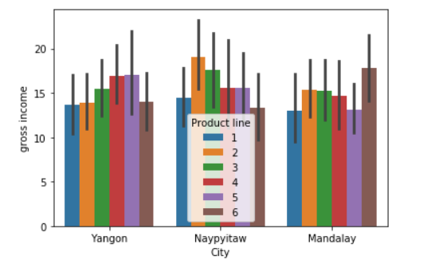
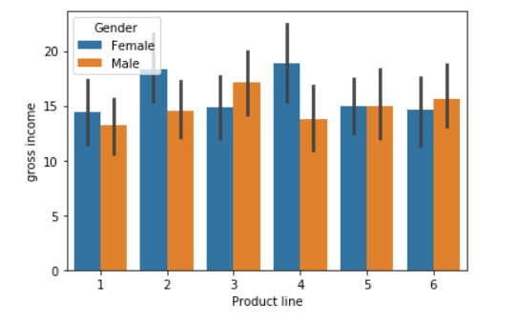
RESULT AND ANALYSIS
We have used heatmap for correlation matrix between the features to find correlation
We have taken the graph between the gross income and cities to find the patterns of product lines
We have taken bar graph between the gross income and product line to find which gender to buying the most

